Slide 1

Turning Data into Decisions: E-Commerce Analytics Case Study
By Nidhi Desai Role : Data Analyst

Slide 2
Table Of Content
Content Index
  Introduction
  Objective
  Database Description
  Table Relationship
  Problem statement
  Queries |Results with visualization
  Recommendation

Slide 3
Introduction
Dataset consists of 4 relational tables: Customers – information about customers, Orders – order details, Order Details – item level order information, and Products – product catalog with pricing and category details. The goal of this case study is to practice data analysis using SQL by writing queries to explore customer behavior, product performance, and sales trends. The final outcome includes business insights that can support decision-making in areas like customer segmentation, product optimization, sales growth, and inventory management.

Slide 4
Project Objective
The objective of this project is to leverage SQL for comprehensive analysis of e-commerce data.
• Efficient Data Analysis using SQL
• Customer Insights & Sales Optimization
• Inventory and Product Management

Slide 5
Dataset Description
The dataset includes the following tables
Customers
customer_id
name,
location
Products
product_id
name,
category,
price
Orders
order_id
order_date
customer_id
total_amount
OrderDetails
order_id
product_id
Quantity
price_per_unit

Slide 6
Entity Relationship Diagram

Slide 7
Problem of Statement
  Identify the top 3 cities with the highest number of customers to determine key markets for targeted marketing and logistic optimization. Objective
  Determine the distribution of customers by the number of orders placed. This insight will help in segmenting customers into one-time buyers, occasional shoppers, and regular customers for tailored marketing strategies
  Identify products where the average purchase quantity per order is 2 but with a high total revenue, suggesting premium product Trend
  For each product category, calculate the unique number of customers purchasing from it. This will help understand which categories have wider appeal across the customer base.
  Analyze the month-on-month percentage change in total sales to identify growth trends.
  Examine how the average order value changes month-on-month. Insights can guide pricing and promotional strategies to enhance order value.
  Based on sales data, identify products with the fastest turnover rates, suggesting high demand and the need for frequent restocking.
  List products purchased by less than 40% of the customer base, indicating potential mismatches between inventory and customer interest.
  Evaluate the month-on-month growth rate in the customer base to understand the effectiveness of marketing campaigns and market expansion efforts.
  Identify the months with the highest sales volume, aiding in planning for stock levels, marketing efforts, and staffing in anticipation of peak demand periods.

Slide 8
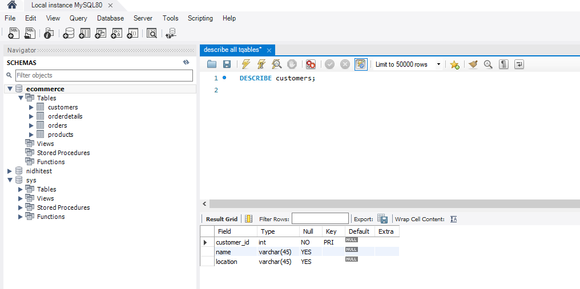
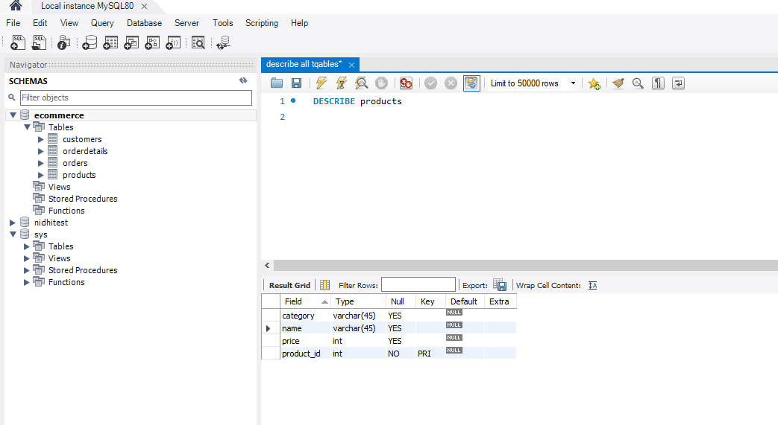
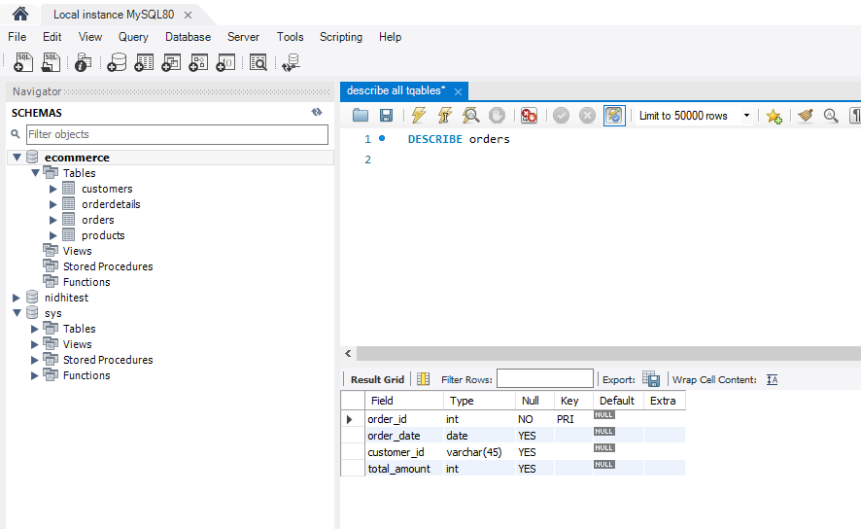
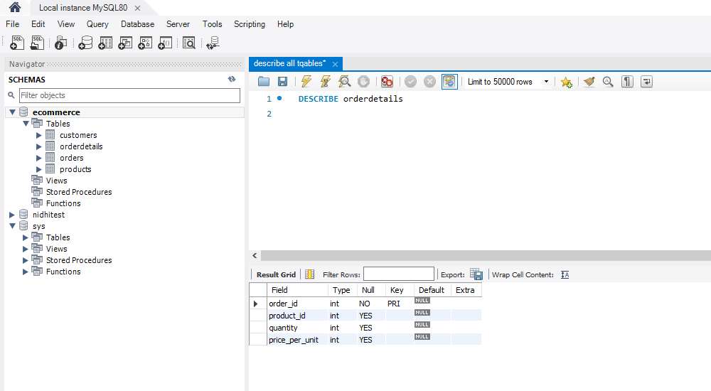
Query 1
Describe the Tables:
DESCRIBE Customers;
DESCRIBE Products;
DESCRIBE Orders;
DESCRIBE OrderDetails;

Slide 9
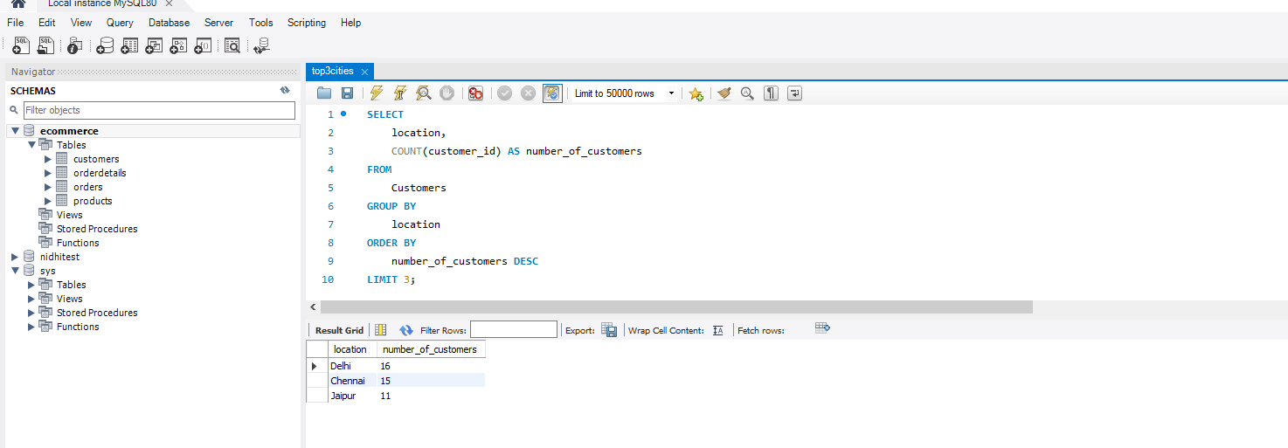
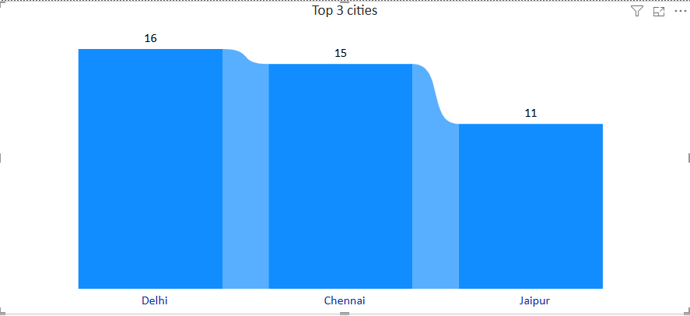
Identify the top 3 cities with the highest number of customers to determine key markets for targeted marketing and logistic optimization.
SELECT
location,
COUNT(customer_id) AS number_of_customers
FROM
Customers
GROUP BY
location
ORDER BY
number_of_customers DESC
LIMIT 3;

Slide 10
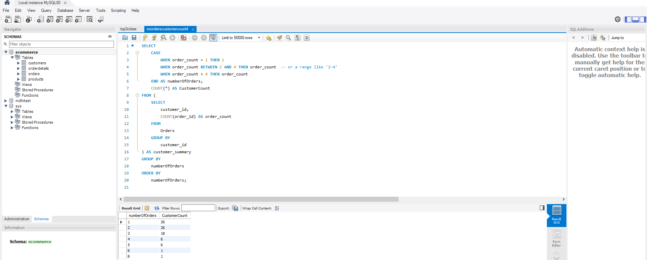
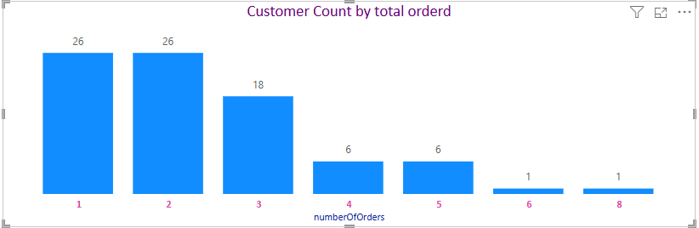
Determine the distribution of customers by the number of orders placed. This insight will help in segmenting customers into one-time buyers, occasional shoppers, and regular customers for tailored marketing strategies.
SELECT
CASE
WHEN order_count = 1 THEN 1
WHEN order_count BETWEEN 2 AND 4 THEN order_count -- or a range like '2-4'
WHEN order_count > 4 THEN order_count
END AS numberOfOrders,
COUNT(*) AS CustomerCount
FROM (
SELECT
customer_id,
COUNT(order_id) AS order_count
FROM
Orders
GROUP BY
customer_id
) AS customer_summary
GROUP BY
numberOfOrders
ORDER BY
numberOfOrders;
Engagement Depth Analysis :
1.As the Number of orders increases, the Customer count decreases.
2. Occasional Shoppers experiences the most

Slide 11
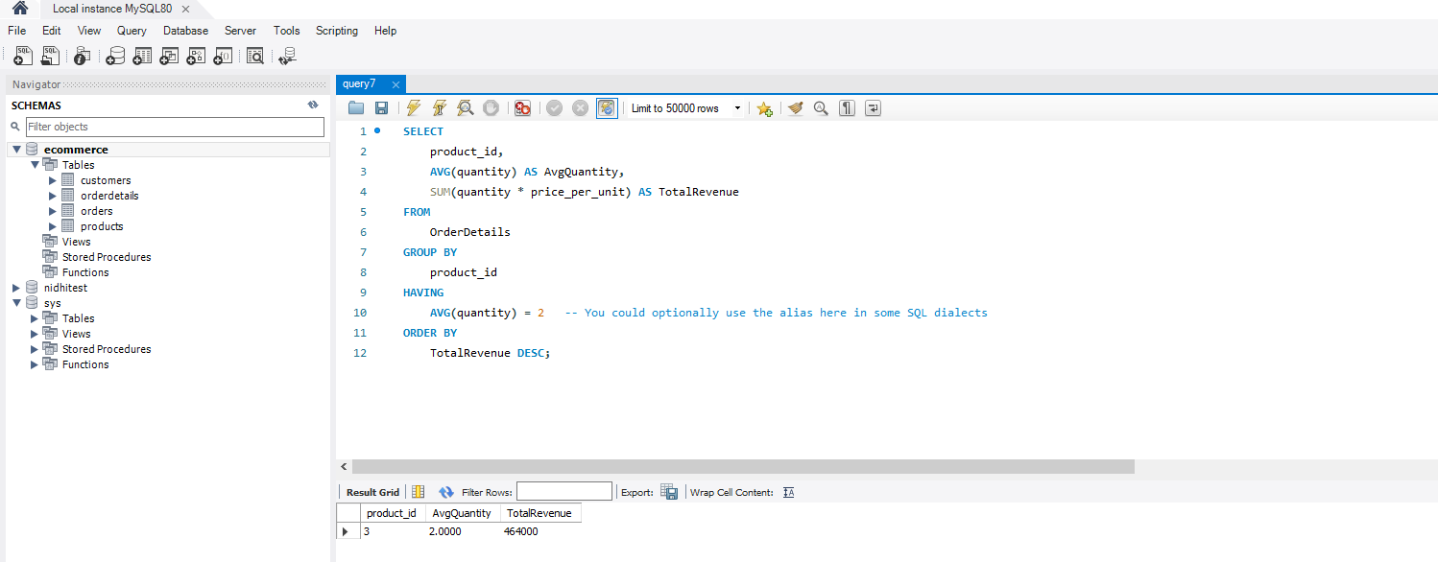
Identify products where the average purchase quantity per order is 2 but with a high total revenue, suggesting premium product trends.
SELECT
product_id,
AVG(quantity) AS AvgQuantity,
SUM(quantity * price_per_unit) AS TotalRevenue
FROM
OrderDetails
GROUP BY
product_id
HAVING
AVG(quantity) = 2 -- You could optionally use the alias here in some SQL dialects
ORDER BY
TotalRevenue DESC;
An average purchase quantity of two Product 1 exhibit the highest total revenue

Slide 12
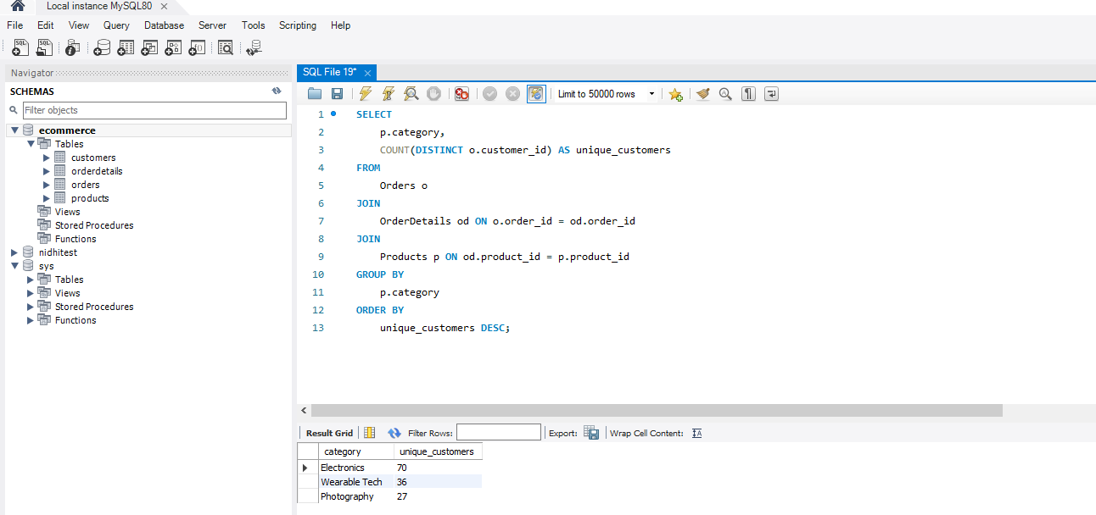
For each product category, calculate the unique number of customers purchasing from it. This will help understand which categories have wider appeal across the customer base. Category-wise Customer Reach
SELECT
p.category,
COUNT(DISTINCT o.customer_id) AS unique_customers
FROM
Orders o
JOIN
OrderDetails od ON o.order_id = od.order_id
JOIN
Products p ON od.product_id = p.product_id
GROUP BY
p.category
ORDER BY
unique_customers DESC;
Electronics category needs more focus as it is in high demand among the customers

Slide 13
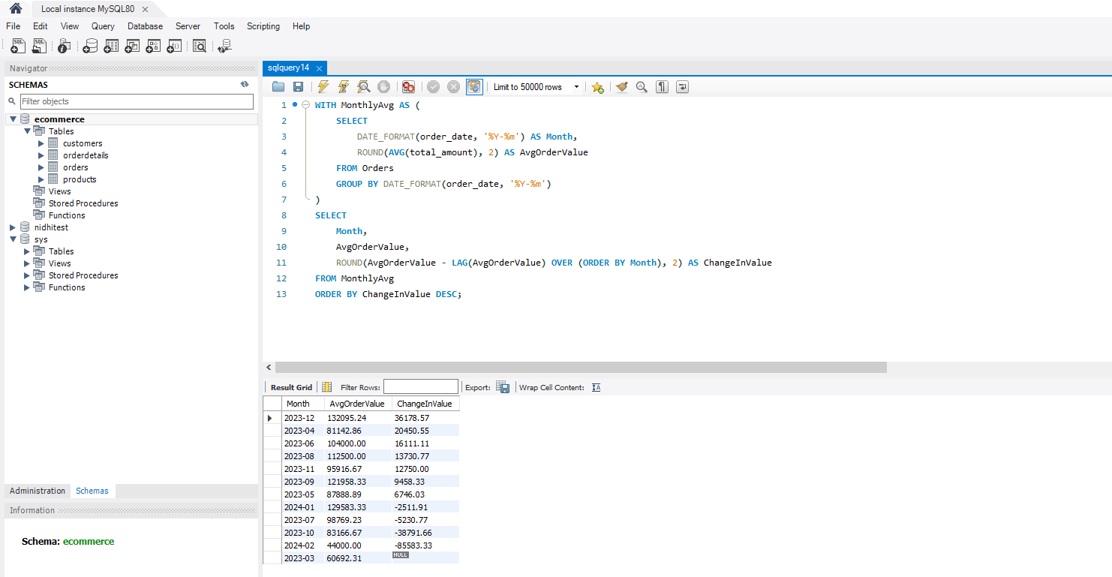
Analyze the month-on-month percentage change in total sales to identify growth trends. Sales Trend Analysis
SELECT
DATE_FORMAT(order_date, '%Y-%m') AS month,
SUM(total_amount) AS TotalSales,
ROUND(
(SUM(total_amount) - LAG(SUM(total_amount)) OVER (ORDER BY DATE_FORMAT(order_date, '%Y-%m')))
/ LAG(SUM(total_amount)) OVER (ORDER BY DATE_FORMAT(order_date, '%Y-%m')) * 100,
2) AS PercentChange
FROM
Orders
GROUP BY
DATE_FORMAT(order_date, '%Y-%m')
ORDER BY
month;
As per Sales Trend Analysis the sales month Feb 2024 experience the largest decline
sales trend from March to August Sales fluctuated with no clear trend.

Slide 14
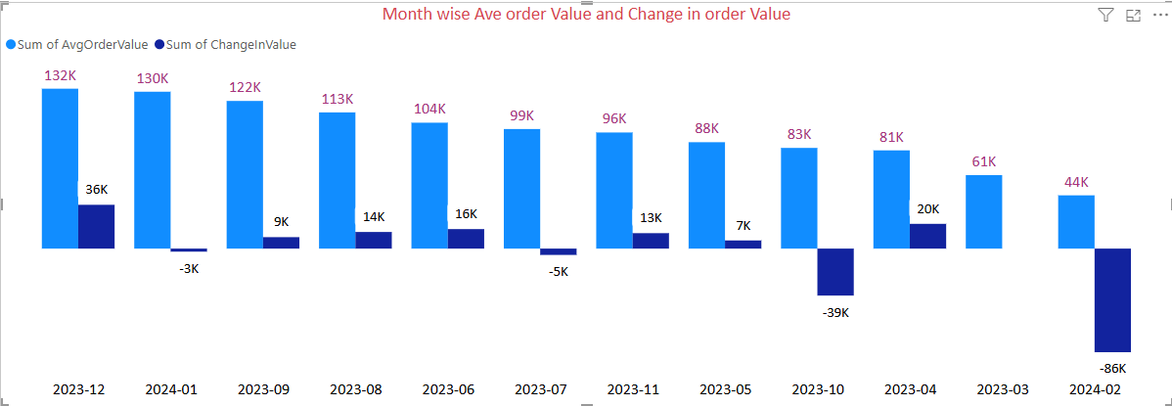
Analyze the month-on-month percentage change in total sales to identify growth trends. Sales Trend Analysis
As per Sales Trend Analysis the sales month Feb 2024 experience the largest decline -86K
sales trend from March to August Sales fluctuated with no clear trend.

Slide 15
Examine how the average order value changes month-on-month. Insights can guide pricing and promotional strategies to enhance order value.
WITH MonthlyAvg AS (
SELECT
DATE_FORMAT(order_date, '%Y-%m') AS Month,
ROUND(AVG(total_amount), 2) AS AvgOrderValue
FROM Orders
GROUP BY DATE_FORMAT(order_date, '%Y-%m')
)
SELECT
Month,
AvgOrderValue,
ROUND(AvgOrderValue - LAG(AvgOrderValue) OVER (ORDER BY Month), 2) AS ChangeInValue
FROM MonthlyAvg
ORDER BY ChangeInValue DESC;
December month has the highest change in the average order value

Slide 16
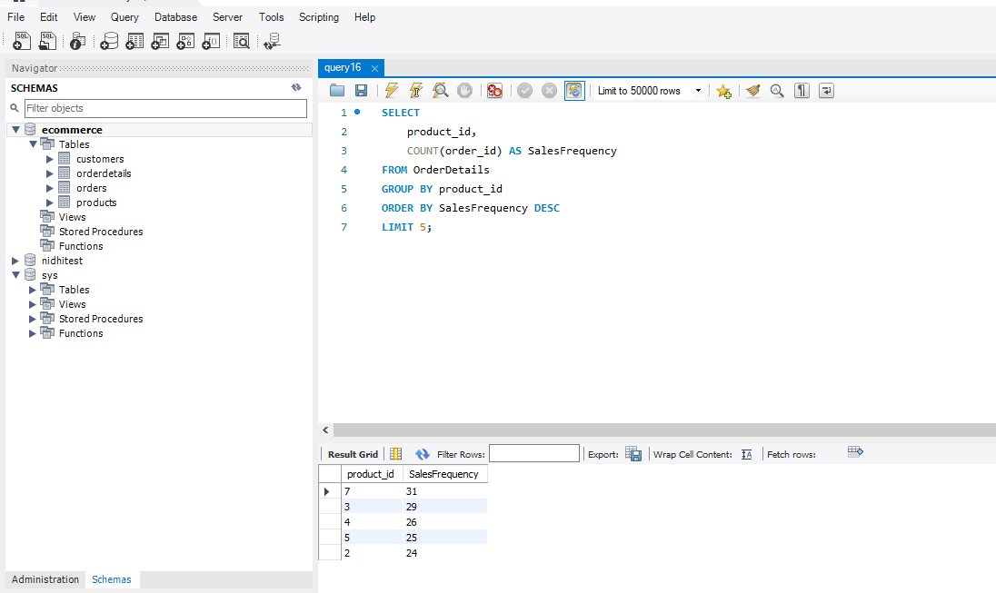
Based on sales data, identify products with the fastest turnover rates, suggesting high demand and the need for frequent restocking.
SELECT
product_id,
COUNT(order_id) AS SalesFrequency
FROM OrderDetails
GROUP BY product_id
ORDER BY SalesFrequency DESC
LIMIT 5;
product_id 7 has the highest turnover rates and needs to be restocked frequently

Slide 17
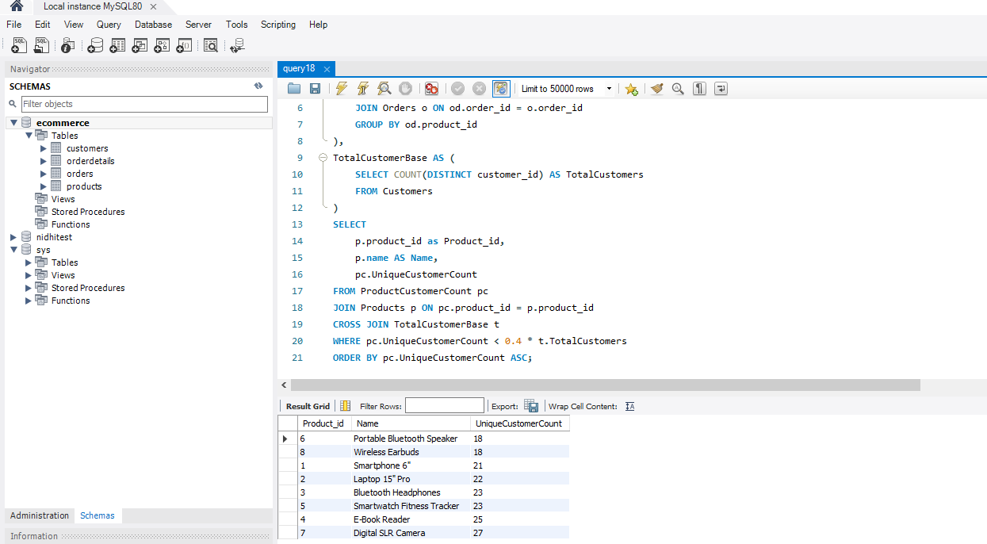
List products purchased by less than 40% of the customer base, indicating potential mismatches between inventory and customer interest -
Low Engagement Products
Due to Poor visibility on the platform products have purchase rates below 40% of the total customer base
strategic action to improve the sales of these underperforming products is Implement targeted marketing campaigns to raise awareness and interest.
WITH ProductCustomerCount AS (
SELECT
od.product_id,
COUNT(DISTINCT o.customer_id) AS UniqueCustomerCount
FROM OrderDetails od
JOIN Orders o ON od.order_id = o.order_id
GROUP BY od.product_id
),
TotalCustomerBase AS (
SELECT COUNT(DISTINCT customer_id) AS TotalCustomers
FROM Customers
)
SELECT
p.product_id as Product_id,
p.name AS Name,
pc.UniqueCustomerCount
FROM ProductCustomerCount pc
JOIN Products p ON pc.product_id = p.product_id
CROSS JOIN TotalCustomerBase t
WHERE pc.UniqueCustomerCount < 0.4 * t.TotalCustomers
ORDER BY pc.UniqueCustomerCount ASC;

Slide 18
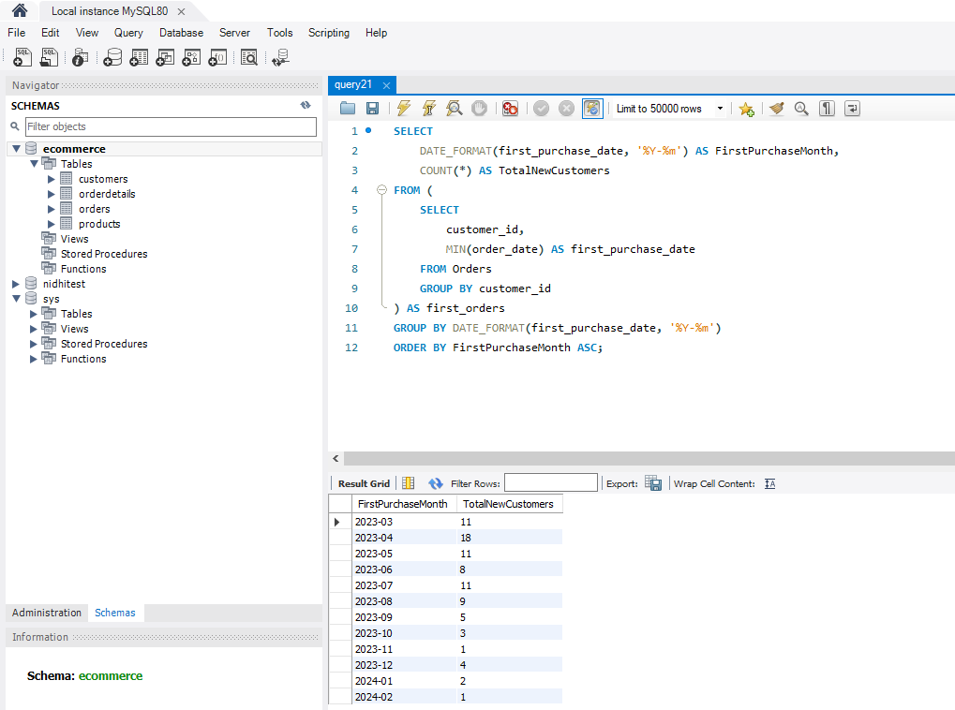
Evaluate the month-on-month growth rate in the customer base to understand the effectiveness of marketing campaigns and market expansion .
Customer Acquisition Trends
SELECT
DATE_FORMAT(first_purchase_date, '%Y-%m') AS FirstPurchaseMonth,
COUNT(*) AS TotalNewCustomers
FROM (
SELECT
customer_id,
MIN(order_date) AS first_purchase_date
FROM Orders
GROUP BY customer_id
) AS first_orders
GROUP BY DATE_FORMAT(first_purchase_date, '%Y-%m')
ORDER BY FirstPurchaseMonth ASC;
It is downward trend which implies the marketing campaign are not much effective.
strategic action to improve the sales of these underperforming products is Implement targeted marketing campaigns to raise awareness and interest.

Slide 19
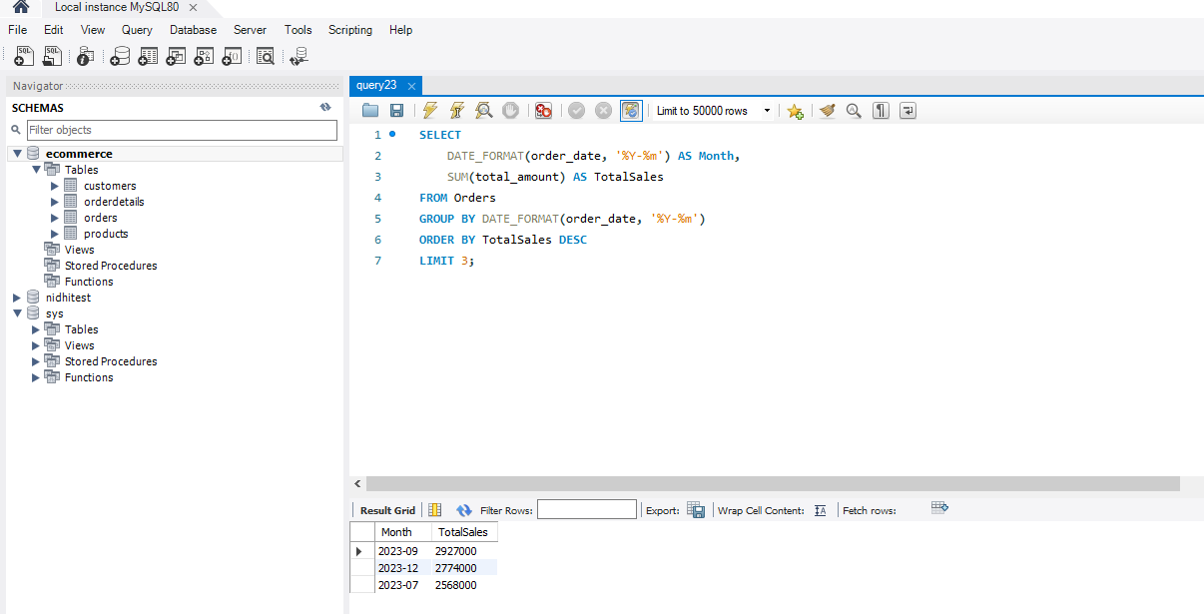
Identify the months with the highest sales volume, aiding in planning for stock levels, marketing efforts, and staffing in anticipation of peak demand periods.
Peak Sales Period Identification
SELECT
DATE_FORMAT(order_date, '%Y-%m') AS Month,
SUM(total_amount) AS TotalSales
FROM Orders
GROUP BY DATE_FORMAT(order_date, '%Y-%m')
ORDER BY TotalSales DESC
LIMIT 3;
September and December months will require major restocking of product and increased staffs

